Slide 1


Slide 2

Credit Card Fraud
Detection

Slide 3
Agenda
Problem Statement 04
Data Mining 5-7
Exploratory Data Analysis (EDA) 8-9
Data Visualization 10
Algorithms Used 11
Analysis of Results 12
Conclusion & Future Work 13

Slide 4
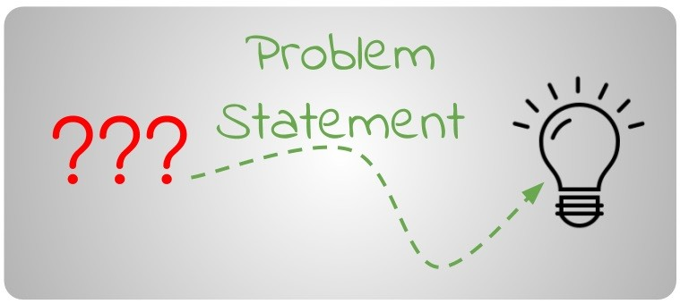
Problem Statement
The Credit Card Fraud Detection Problem includes modeling past credit card transactions with the knowledge of the ones that turned out to be fraud.
This model is then used to identify whether a new transaction is fraudulent or not.
Our aim here is to detect 100% of the fraudulent transactions while minimizing the incorrect fraud classifications.
Question: Whether the transaction is Fraud or not ?
Solution: Involves looking at recent features in the Transaction.

Slide 5
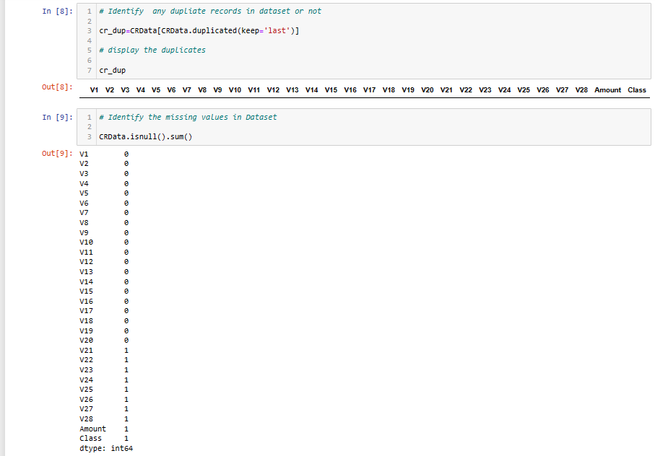
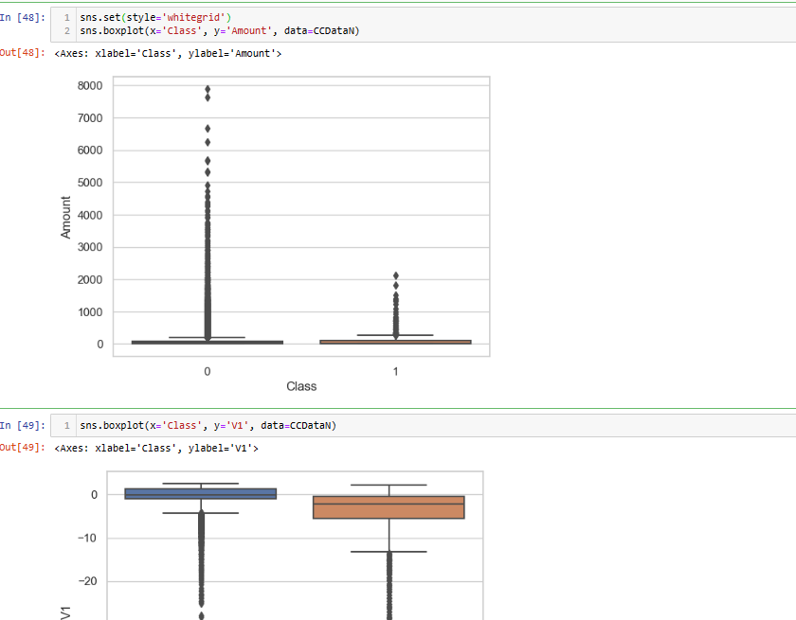
Data Mining - 01
Data Preprocessing
Data Cleaning:
This involves identifying and correcting errors or inconsistencies in the data, such as missing values, outliers, and duplicates.
Various techniques can be used for data cleaning, such as imputation, removal, and transformation.

Slide 6
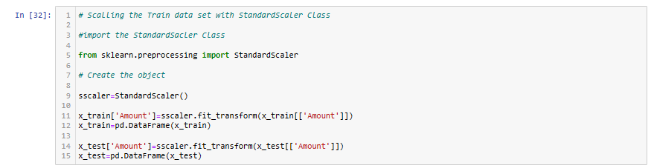
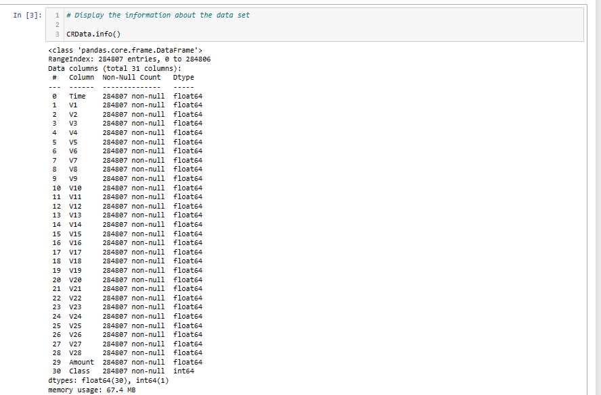
Data Mining - 02
Data Preprocessing
Data Transformation(Scaling and Encoding):
This involves converting the data into a suitable format for analysis.It include normalization, standardization, and discretization.
It is done in order to scale the data values in a specified range by importing sklearn.preprocessing.StandarScaler and sklearn.preprocessing.MinMaxScaler.
Discretization is used to convert continuous data into discrete categories.

Slide 7
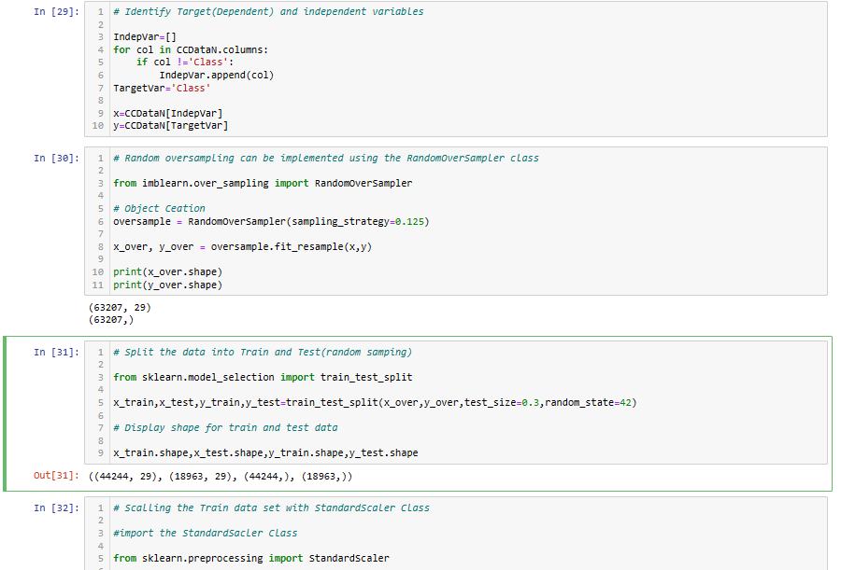
Data Mining - 03
Data Reduction (selecting features)
Data reduction is a crucial step in the data mining process that involves reducing the size of the dataset while preserving the important information.
The Given Data set is imbalance(Proportion >10 : 1).So before data reduction we have to oversample the dataset by using imblearn.over_sampling.RandomOverSampler class.
Then split the data into Train and Test(random sampling) data by using sklearn.model_selection.train_test_split.

Slide 8
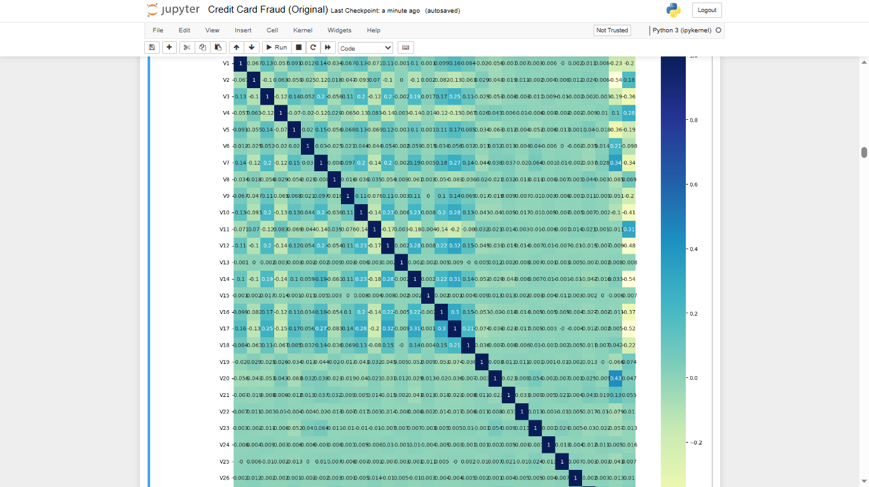
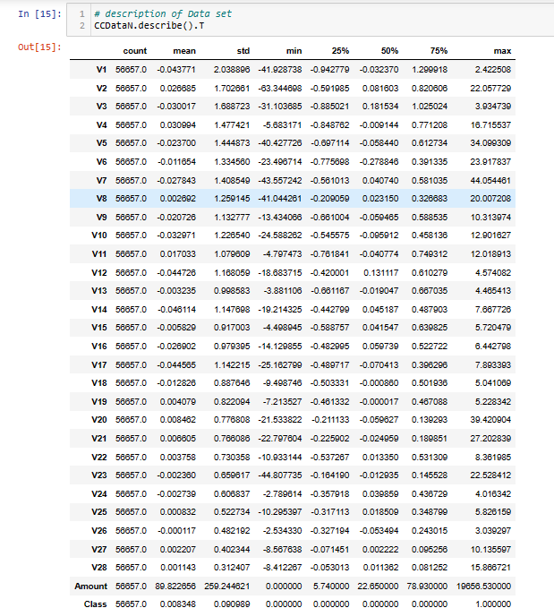
Exploratory Data Analysis (EDA)
Exploratory Data Analysis refers to the crucial process of performing initial investigations on data to discover patterns to check assumptions with the help of summary statistics and graphical representations.

Slide 9
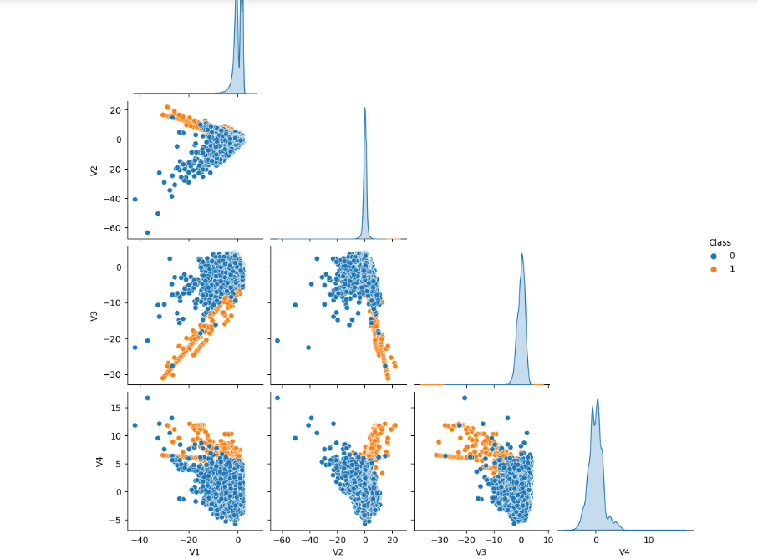
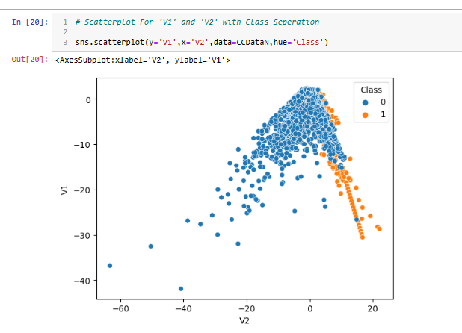
Exploratory Data Analysis (EDA)
Pair Plot
Scatter plot

Slide 10
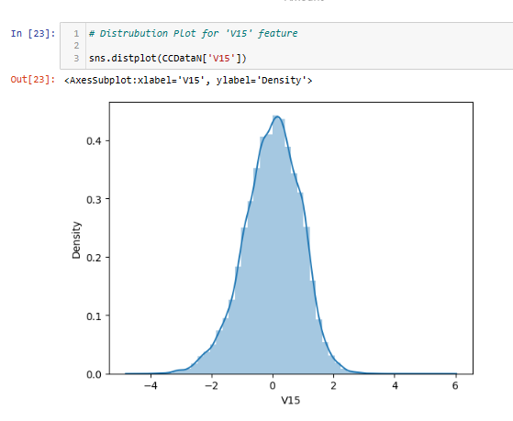
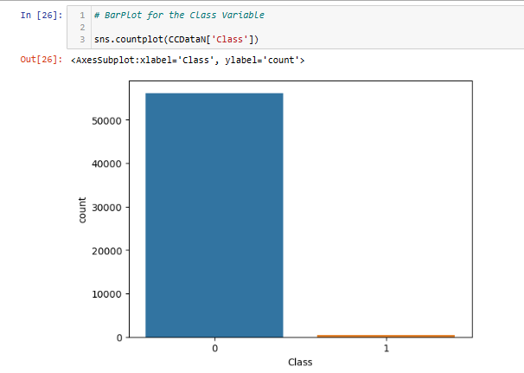
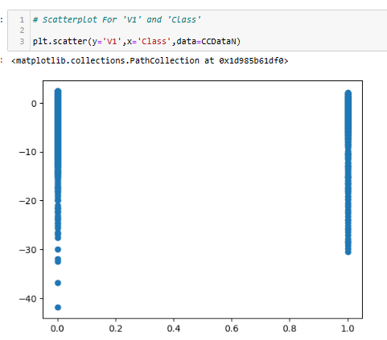
Data Visualization
Distribution Plot
Bar Plot
Scatter Plot

Slide 11
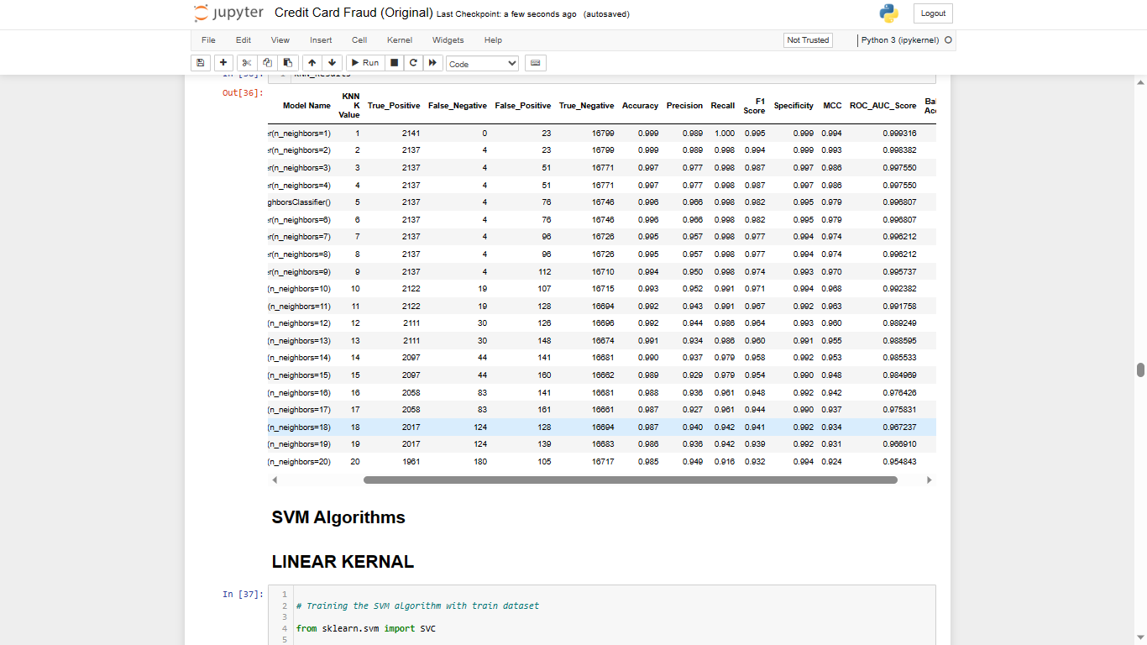
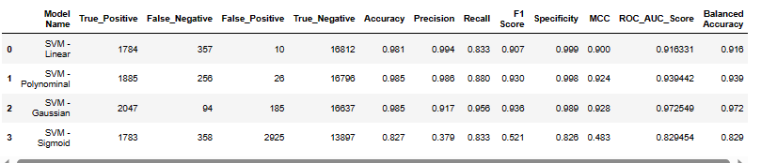
Algorithms Used
Data science machine learning algorithms are used to solve regression and classification problems. Machine learning algorithms treats an entire dataset as a training dataset. After training a model with the algorithm, data scientists aim to predict the result of a new data point.
The Credit Card Fraud Detection Problem is a Classification problem. So I use Following Algorithms :
K-Nearest Neighbors (KNN)
Support Vector Machine(SVM)
Logistic Regression
Decision Trees
Random Forests
Extra Trees
Naive Bayes
Note: The Polynomial kernel, n_neighbors=1 given the better accuracy for SVM and KNN algorithms respectively , So I choose these to train the model.

Slide 12
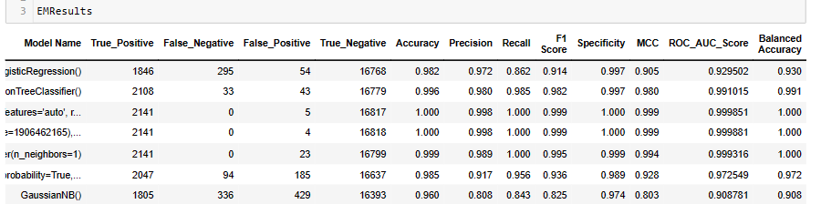
Analysis of Results
The algorithm analysis is based on following factors.
Accuracy is the simplest metric and can be defined as the number of test cases correctly classified divided by the total number of test cases.
F1 score is the harmonic mean of Recall and Precision.Precision will be required to save on the company’s cost and recall will be required to ensure that the machinery is stable and not a threat to human lives.
ROC(Receiver Operating Characteristics) curve is a plot of true positive rate against false positive rate. If ROC has the higher the area, then it has better the model performance.

Slide 13
Conclusion and Future Work
The Extra Tree Classification algorithm has better accuracy, F1 score and ROC accurate score.It has better performance among all the algorithms.
Hence ExtraTreeClassification Algorithm is selected for our credit card fraud detection model.

Slide 14
Thank You
Q & A
Ramayanapu Narasimha Rao
21B91A05Q6
SRKR Engineering College
Mobile: +91 8143972766
Email: 21B91A05Q6@srkrec.ac.in
Bhimavaram - India

